Slide 1


The Irish Higher Education Landscape
Induction Presentation
Naomi Jackson
Dean of Academic Affairs

Slide 2


This powerpoint has sound!
In order to fully experience this presentation, please click on Slide Show, then click From Beginning. This will enable you to hear the sound
Alternatively click on the megaphone in the bottom right corner on each slide and press play

Slide 3
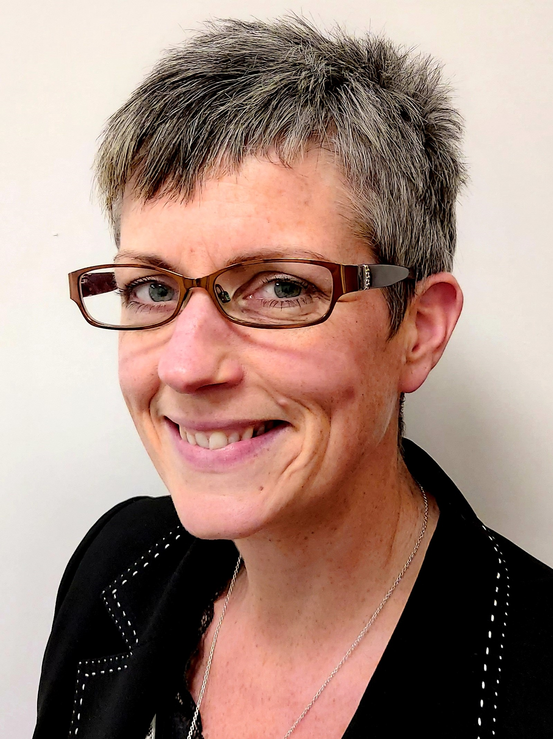

Presentation Overview
Higher Education Institutions
Award types and levels
National Framework of Qualifications
Award classifications

Slide 4
Higher Education Institutions
Universities and Designated Awarding Bodies
Institutes of Technology and Technological Universities
Independent Colleges

Slide 5
Award Types and Levels
Major, minor, special purpose and supplemental awards
Progression through the framework
Higher education qualifications are at levels 6 – 10

Slide 6
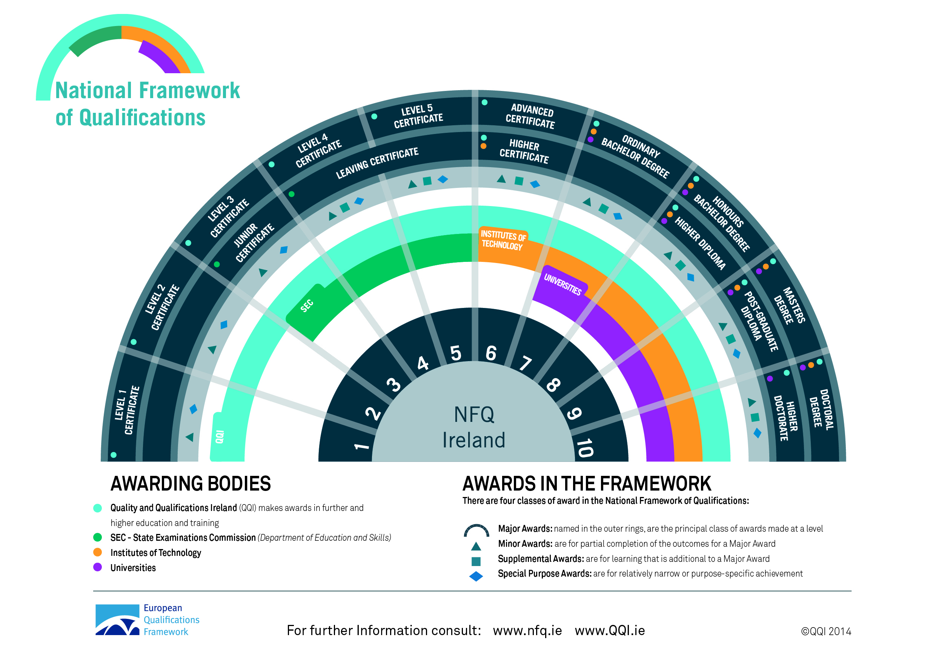
National Framework of Qualifications
nfq.qqi.ie

Slide 7
Award Classifications
Final award classifications
Grading systems – variation between countries
Classification | Boundary
Distinction or First class honours | 70%
Merit 1 or Second class honours grade 1 | 60%
Merit 2 or Second class honours grade 2 | 50%
Pass | 40%

Slide 8


